Slide 1

Retail Data Warehouse — End-to-End ETL Project
Technology: Snowflake • Architecture: RAW → Profiling → Transformation → Star Schema
PRESENTED BY: Team CCID

Slide 2

Project Objective
Build a scalable, cloud-native data warehouse on Snowflake
Clean & validate raw source data for reliability
Enable analytics & reporting (BI-ready)
Support efficient incremental loads
Implement SCD Type 2 for customer history

Slide 3
Architecture Overview
Internal Stage
Raw Layer
Profiling
Transformation
Secure file ingestion (staged files)
Landing tables: exact source shape
Quality checks & metrics
Business rules, joins, types
Star Schema (DW)
Fact & dimension tables for analytics

Slide 4

STAGING LAYER
The staging layer is the temporary storage area in Snowflake where we upload our source files before loading them into tables.
We use the COPY INTO command to load data from the stage into raw tables.
Raw Layer Tables
Here, we store data exactly as it comes from the source system.
We do not apply any transformation or cleaning at this stage.
customers_raw
orders_raw
order_items_raw
payments_raw
products_raw

Slide 5

Data Profiling
Data profiling means checking the quality of data before transforming it into the data warehouse.
Row count validation - compare the number of records in the source file with the number of records loaded into the raw table.
NULL & type mismatch checks - checked that important columns like IDs were not NULL
Duplicates detection(keys) - We checked for duplicate primary keys
Negative / orphan checks
Future date checks

Slide 6
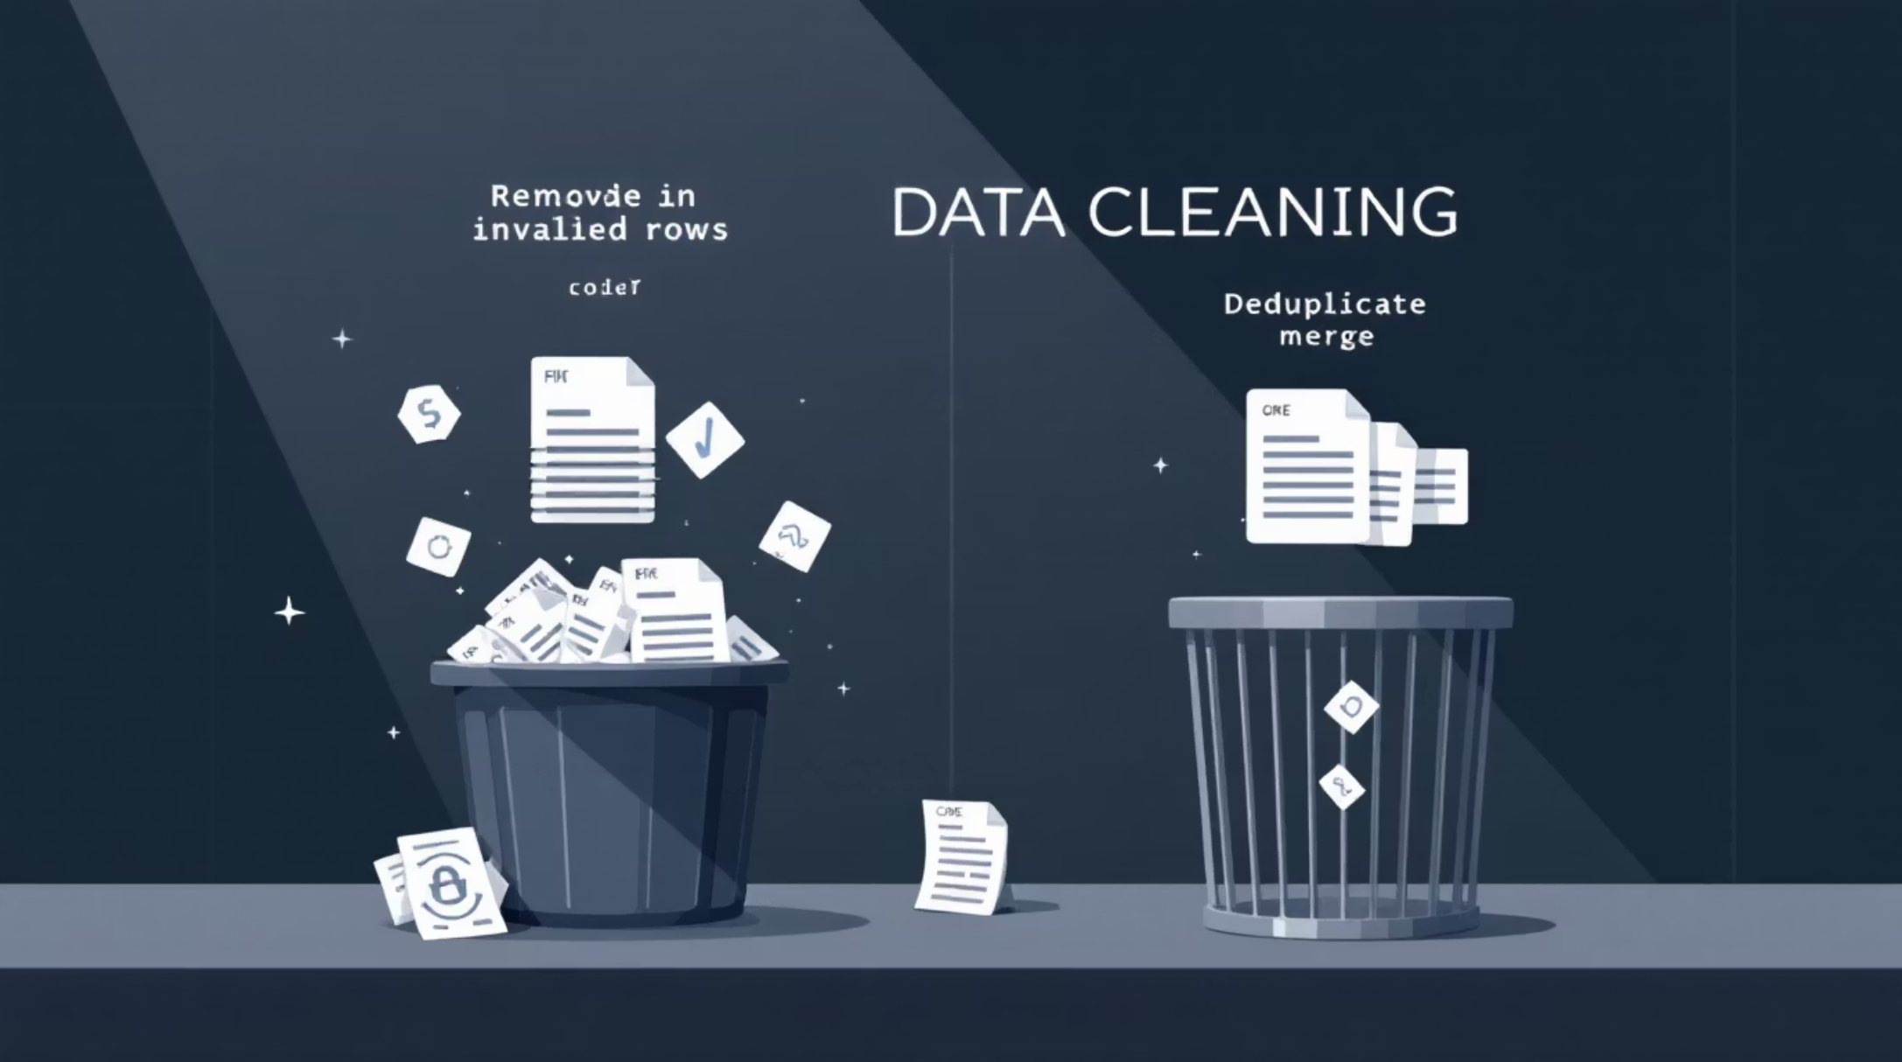
Data Cleaning Strategy
Remove NULL / invalid records
Delete orphan records (missing FK)
Deduplicate via ROW_NUMBER() window
Filter negative / out-of-range values
Normalize & validate date formats

Slide 7



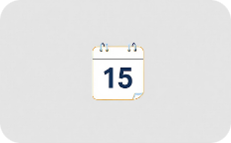
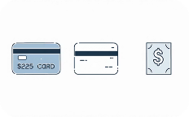
Star Schema Design (Summary)
dim_customer
dim_product
dim_location
dim_date
Product attributes, category
Store / geo attributes
Date hierarchies (day/month/quarter)
SCD Type 2 — surrogate key, historical rows
dim_payment
Payment type & status
Central fact: fact_sales (surrogate keys + measures)

Slide 8
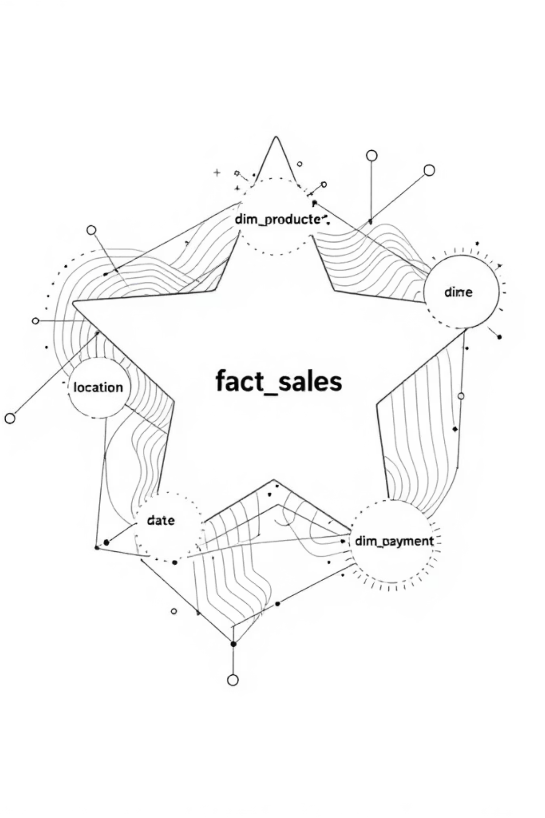
Star Schema Diagram
Fact at center with clear FK relationships to each dimension — ready for BI tools

Slide 9
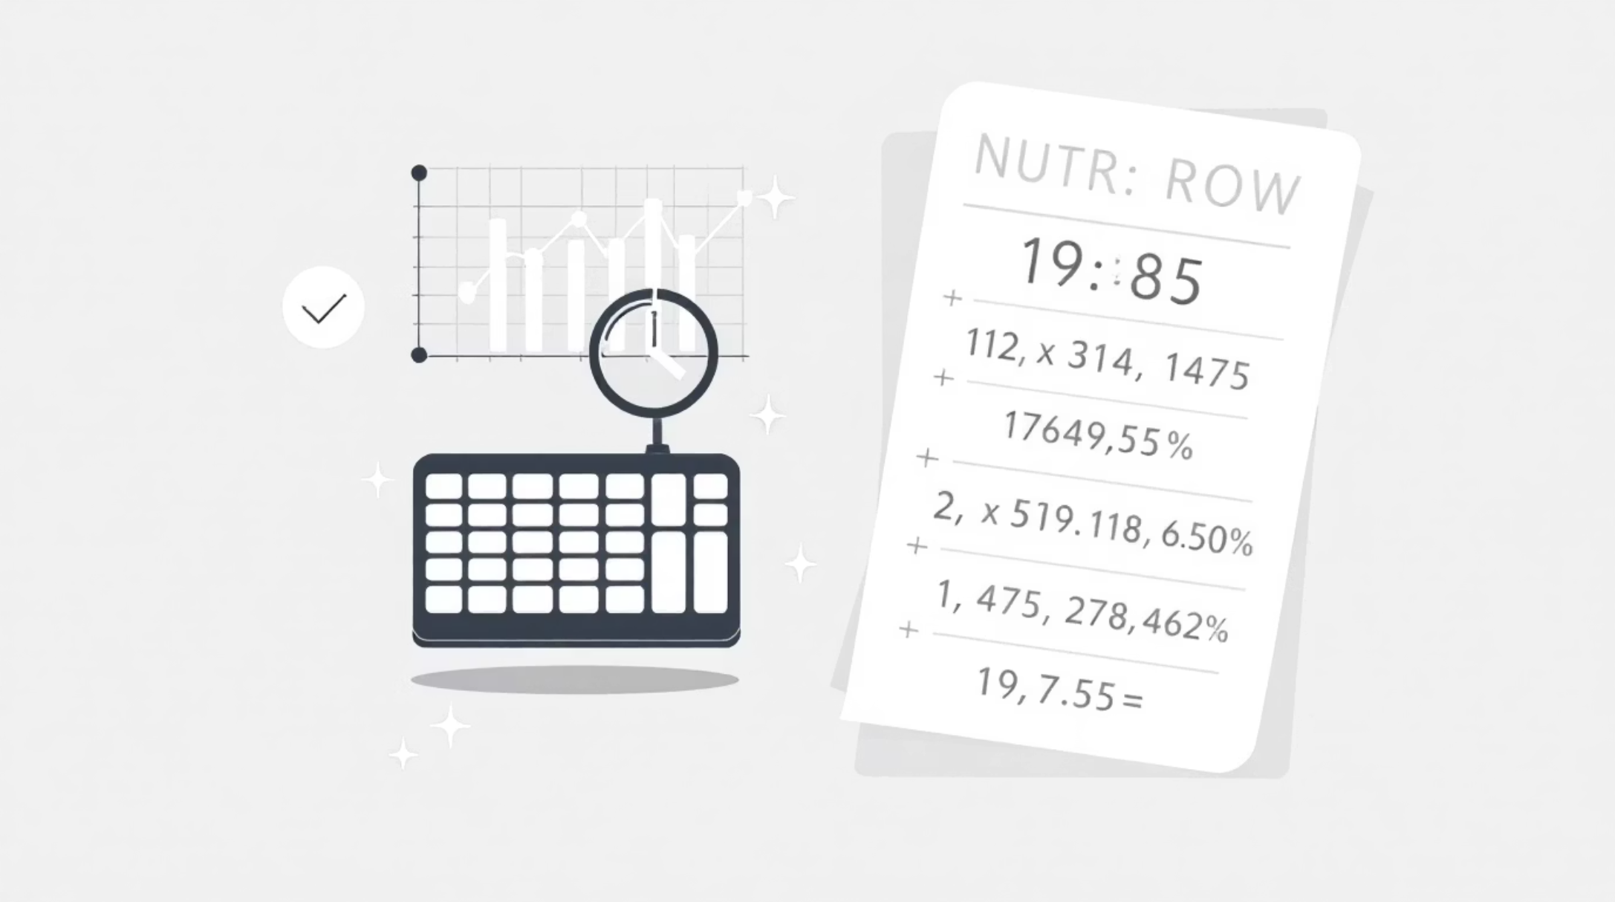
Fact Table Design (Grain)
Grain: one row per order × product (order_line)
Measures: quantity, unit_price, line_amount, payment_amount
Foreign keys: customer_key, product_key, date_key, location_key, payment_key
Surrogate keys and consistent data types

Slide 10
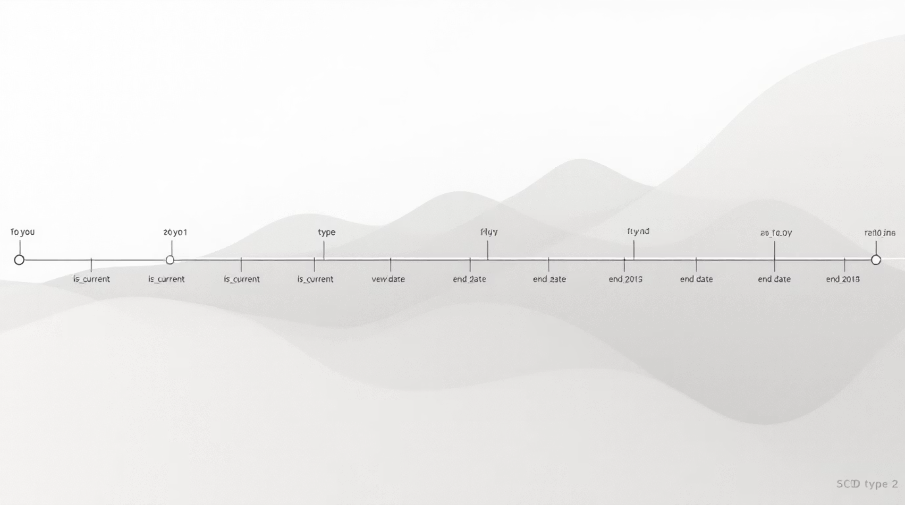
SCD Type 2 Implementation
Expire old rows: set end_date, is_current = FALSE
Insert new rows with new surrogate key
Maintain effective_start / effective_end dates
Preserve full change history for customers

